Slide 1


CSC 690 CAPSTONE PROJECT
GROUP 21
CLINICAL EXPERT

Slide 2


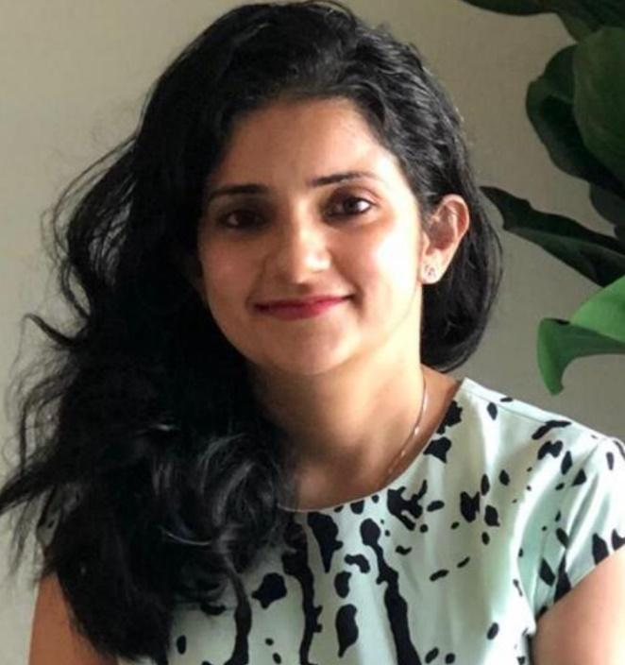
Department of Computer Science and Software Engineering
Aishwarya Prakash Kembhavi Student Id: 95672 Masters: Computer Science kembhaviaishw3138@students.itu.edu Years of experience- 1.7 years | Priya Phapale Student Id: 94662 Masters: Computer Science phapalepriya2694@students.itu.edu Years of experience- 5 years | Shivani Sachdeva Student Id: 88785 Masters: Software Engineering 88785.sachdeva@students.itu.edu Years of experience- 5 years

Slide 3

MOTIVATION

Slide 4
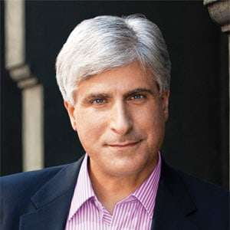
“Everyday decision making around the world is constantly based on what came before us.”
—Steve Berry

Slide 5

Problem Statement
No readily-available software
Latest clinical articles
Huge amount of data
Less time to diagnose
Each patient is different
Emergency decision making is hard.
Finding relevant articles is challenging
Ref: https://medlaunchsolutions.com/2018/03/the-busy-doctor/

Slide 6

Goal
Help doctors to find the relevant articles.
Save time in emergency
Better diagnosis
Machine learning
Summarize of patient’s diagnosis data
Extract medically relevant keywords
Match and find most relevant articles
https://www.freepik.com/premium-photo/serious-male-doctor-working-laptop-clinic_3453438.htm

Slide 7
Emergency cases as per CDC
E m e r g e n c y D e p a r t m e n t +
Total cases | Injury cases | Other cases | ED patient resulting to admission | ED patient resulting to ICU | Visits with patient 15 min or less | Transferred to other hospital
139.0 m | 40.0 m | 43.3 m | 14.5 m | 2.0 m | 40.4% | 2.2%
Ref: National Hospital Ambulatory Medical Care Survey: 2017 Emergency Department Summary, tables 1, 4, 14, 24, 25

Slide 8
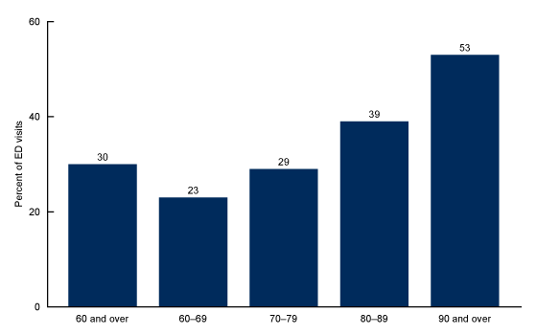
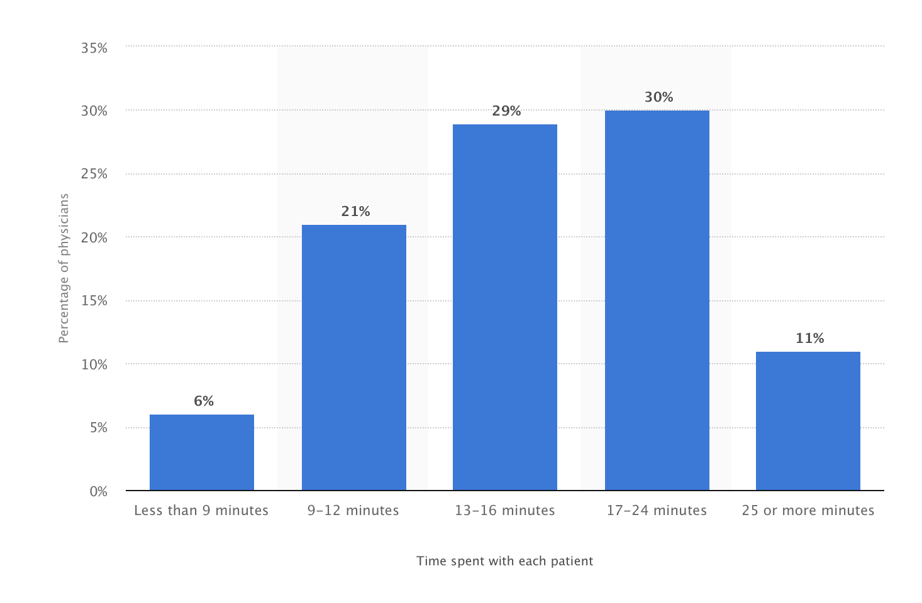
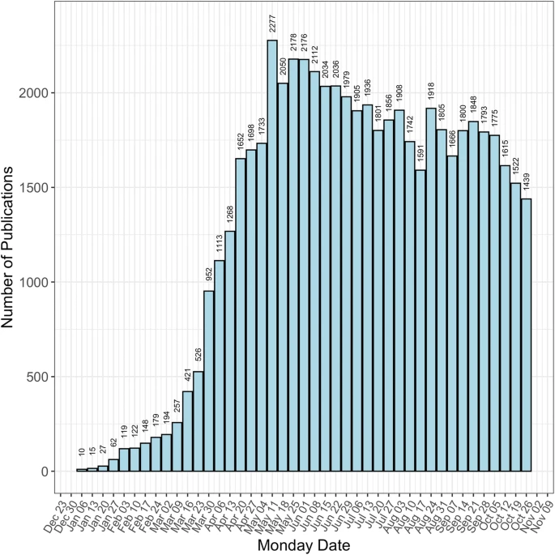
Emergency Department statistics
Emergency visits as per age
Statistics of time spent with patient by doctor.
No of articles published per
year
https://www.cdc.gov/nchs/products/databriefs/db367.htm

Slide 9

Timeline
Motivation
Research
Data
gathering
Execution
Project
Idea
Methodology
Implementation
Result
analysis
SEP
SEP
OCT
OCT
NOV
NOV
DEC
DEC

Slide 10

PROJECT PLAN

Slide 11
PROJECT PLAN
Data gathering
MeSH medical Ontology
Summarization
Performance
clinical summaries
Examine the performance
Extraction
Scoring
Keywords
Remove stopwords
Identify keywords
Scoring as per matched keywords
Matching
Matching the keywords

Slide 12


Data gathering
MESH (Medical subject headings / summaries)
National Center for Biomedical Ontology.
Too large about 250,000 terms
Shrinked to 50,000 terms
Filter unimportant data in the files:
Remove unnecessary information.
Ref: https://bioportal.bioontology.org/ontologies/MESH/?p=summary
Image - https://theintelligenceofinformation.files.wordpress.com/2016/11/transitive_closure-svg.png?w=324

Slide 13
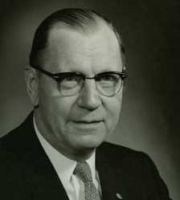

RESEARCH ABOUT TEXT SUMMARIZATION
Hans Peter Luhn
Harsh Desai
Year: 1958
Title: The automatic creation of literature abstracts
Year: 2016
Title: NLP Based Text Summarization Using Semantic Analysis
Ref: https://courses.ischool.berkeley.edu/i256/f06/papers/luhn58.pdf
https://media.neliti.com/media/publications/239678-nlp-based-text-summarization-using-seman-50aacb42.pdf

Slide 14
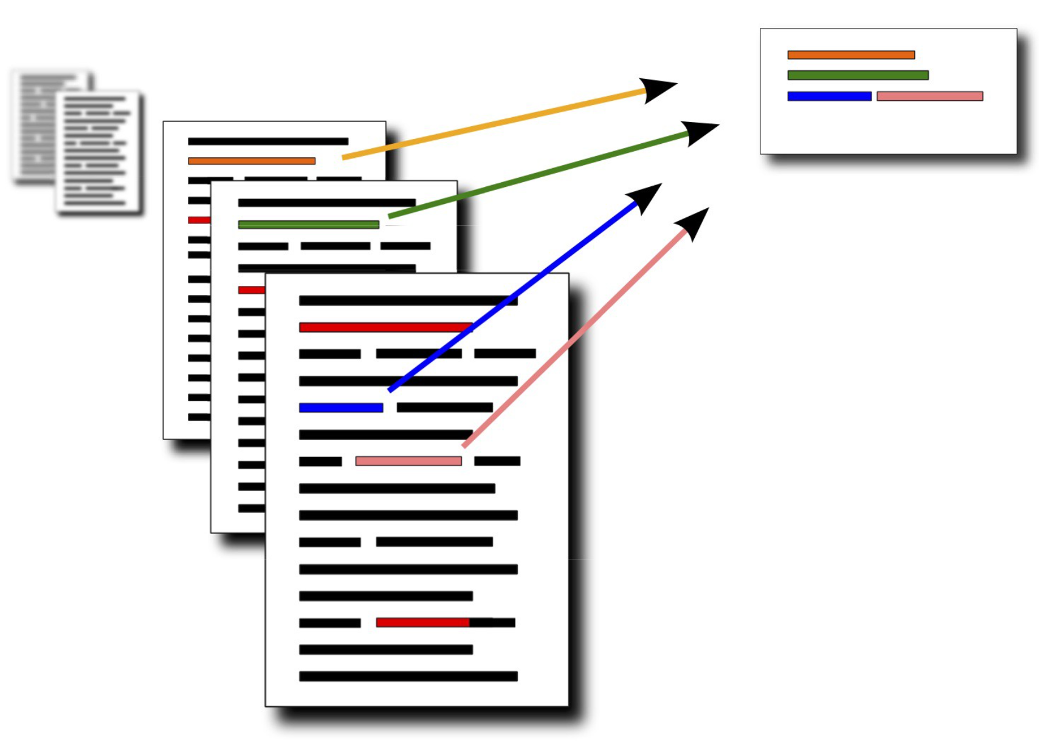
TEXT SUMMARIZATION
Distilling the most important information
Generates concise and precise summary.
Removes unwanted information
Enhances the readability
Reduces time spent in researching
Difficult and costly if done manually.
https://towardsdatascience.com/automatic-text-summarization-simplified-3b7c10c4093a
https://machinelearningmastery.com/gentle-introduction-text-summarization/#:~:text=Text%20summarization%20is%20the%20process,and%20task%20(or%20tasks).Ref: https://bioportal.bioontology.org/ontologies/MESH/?p=summary
Image - https://theintelligenceofinformation.files.wordpress.com/2016/11/transitive_closure-svg.png?w=324
Ref: https://machinelearningmastery.com/gentle-introduction-text-summarization/#:~:text=Text%20summarization%20is%20the%20process,and%20task%20(or%20tasks).

Slide 15
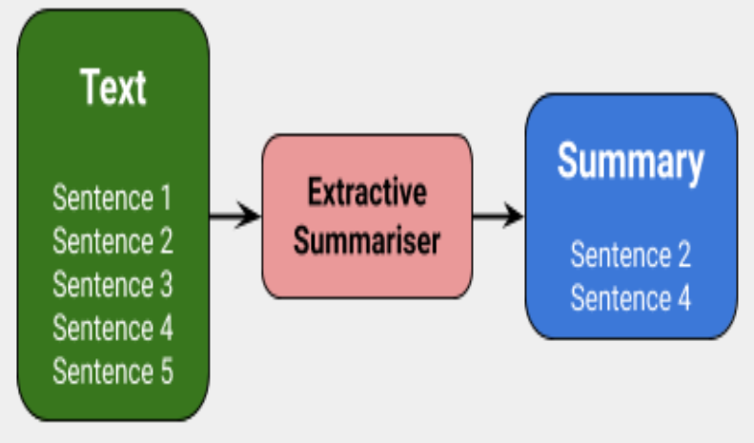
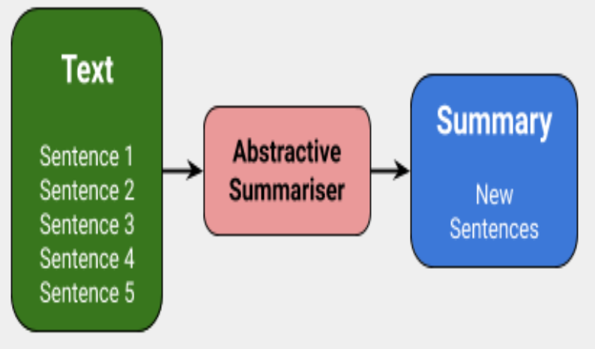
TYPES OF TEXT SUMMARIZATION
01
EXTRACTIVE
SUMMARIZATION
02
ABSTRACTIVE SUMMARIZATION
We are using extractive summarization in our project
Ref: https://www.analyticsvidhya.com/blog/2018/11/introduction-text-summarization-textrank-python/

Slide 16
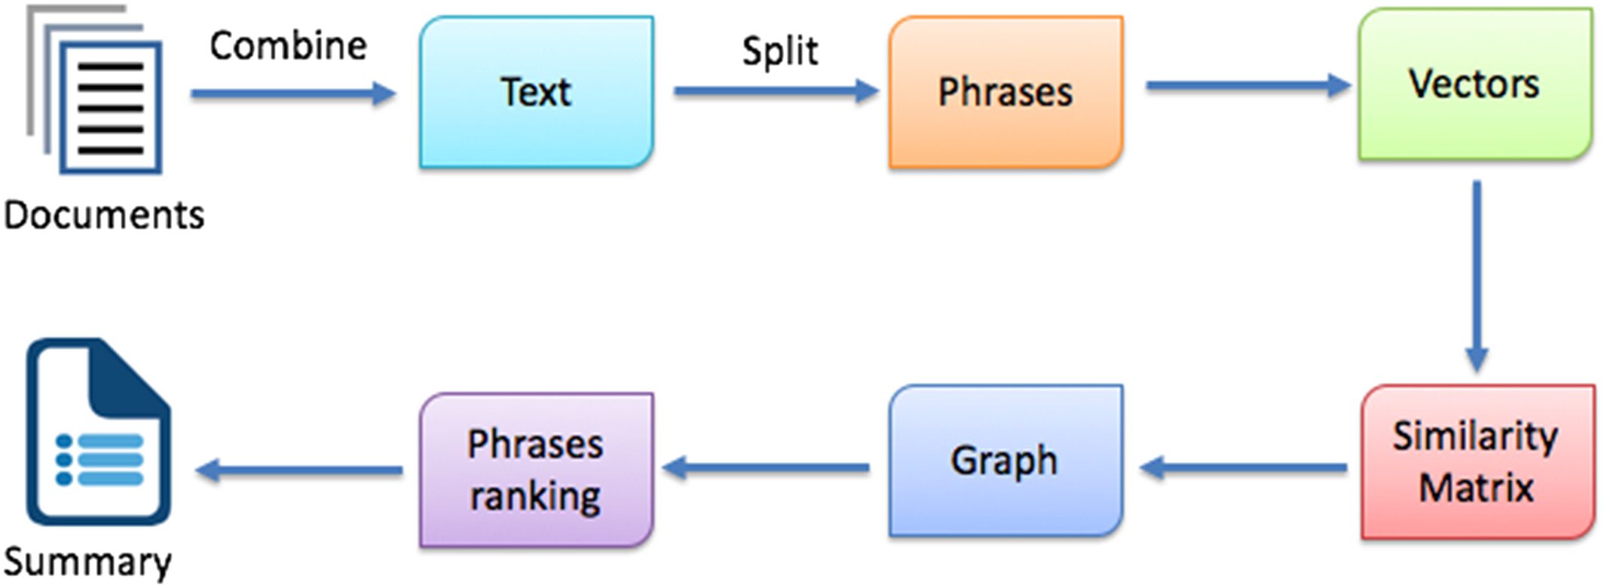
FLOW OF TEXTRANK ALGORITHM
Ref: https://onlinelibrary.wiley.com/doi/abs/10.1002/sres.2648

Slide 17

MATCHING AND SCORING
Read summaries
Read article files
Match with articles
Scoring (max keywords)
Ref: https://www.google.com/search?q=doctor+thumbs+up+with+laptop&tbm=isch&ved=2ahUKEwimyvqukNbtAhVDgZ4KHYWUAegQ2-cCegQIABAA&oq=doctor+thumbs+up+with+laptop&gs_lcp=CgNpbWcQAzoCCAA6BAgAEEM6BggAEAgQHlDJSVjfX2DlYWgAcAB4AIABTIgBnwaSAQIxMpgBAKABAaoBC2d3cy13aXotaW1nwAEB&sclient=img&ei=I-TbX-asHsOC-gSFqYbADg&bih=585&biw=1280&rlz=1C5CHFA_enUS921US921#imgrc=Bcj1sSPYA1rR-M

Slide 18

IMPLEMENTATION

Slide 19









NATURAL LANGUAGE PROCESSING
Integral part of Deep learning
Focuses on extracting meaningful data from text
Train data models
Text mining
Text classification & Text analysis
Sentiment analysis & word sequencing
Speech recognition & generation
Machine translation, and dialog systems
https://www.upgrad.com/blog/python-nlp-libraries-and-applications/

Slide 20

Why Gensim and NLTK?
Gensim
NLTK
Admiral & Specialized
Provides Vectorization
Platform Independent
Open source
Scalable
Extracts automatically
Robust & Efficient
Fast & Extensible
Full NLP library
Stopwords
Fast sentence tokenization
Supports largest no. of languages
Ref : https://medium.com/activewizards-machine-learning-company/comparison-of-top-6-python-nlp-libraries-c4ce160237eb

Slide 21

PACKAGES AND FUNCTIONS
Packages
re package
os package
Glob package
Sys package
Csv package
Functions
summarize()
keywords()
word_tokenize()
Punkt
stopwords()
Ref : https://docs.python.org/3/search.html?q=re&check_keywords=yes&area=default

Slide 22

CODE DEMO

Slide 23

MOCK UP SCREENS
Welcome to Clinical Expert!

Slide 24


Slide 25
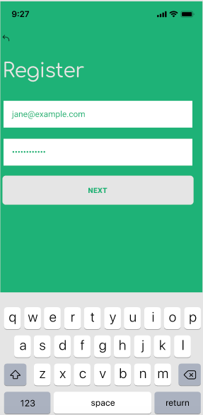

Slide 26
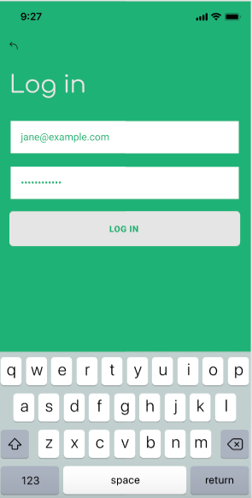

Slide 27
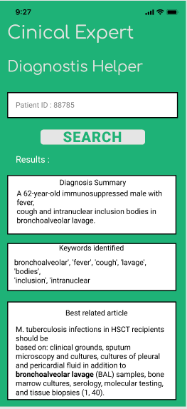

Slide 28
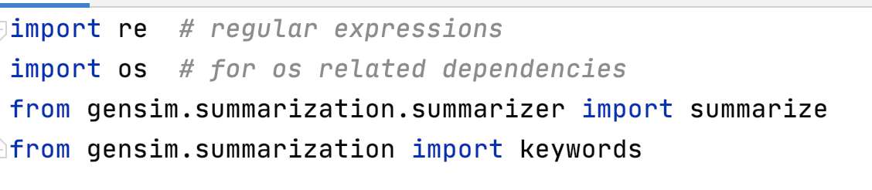
Importing packages

Slide 29
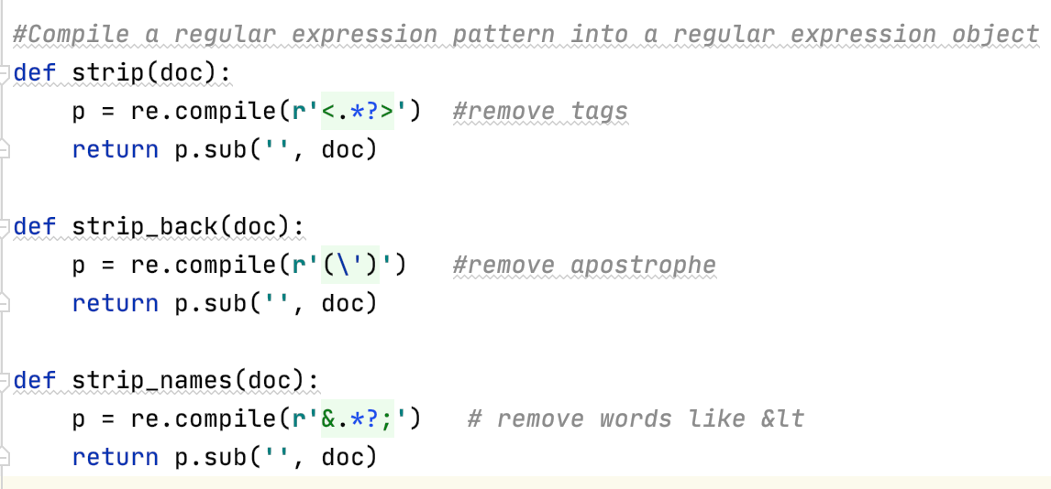
Regular Expressions

Slide 30
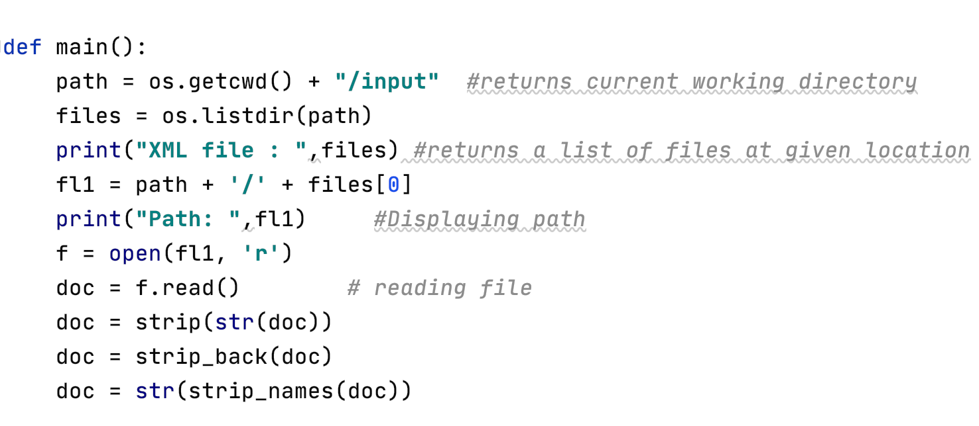
Working with Input Data

Slide 31
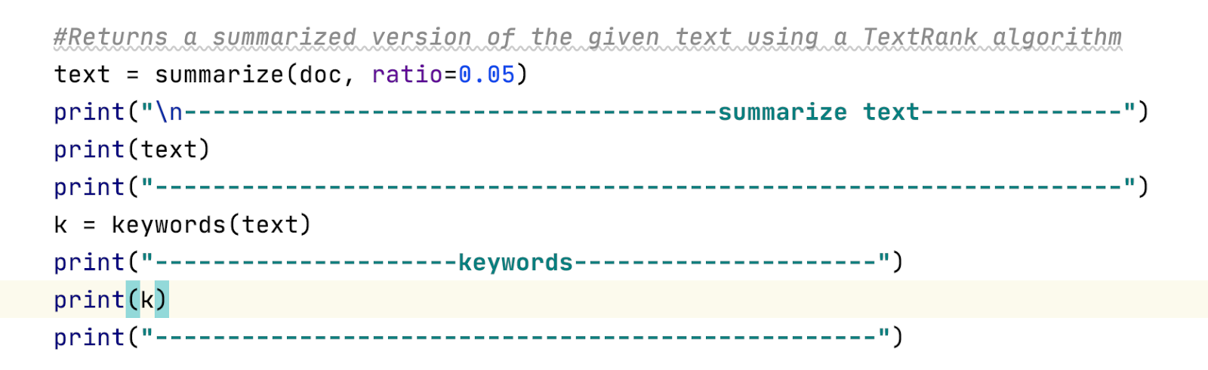
Text Summarization

Slide 32
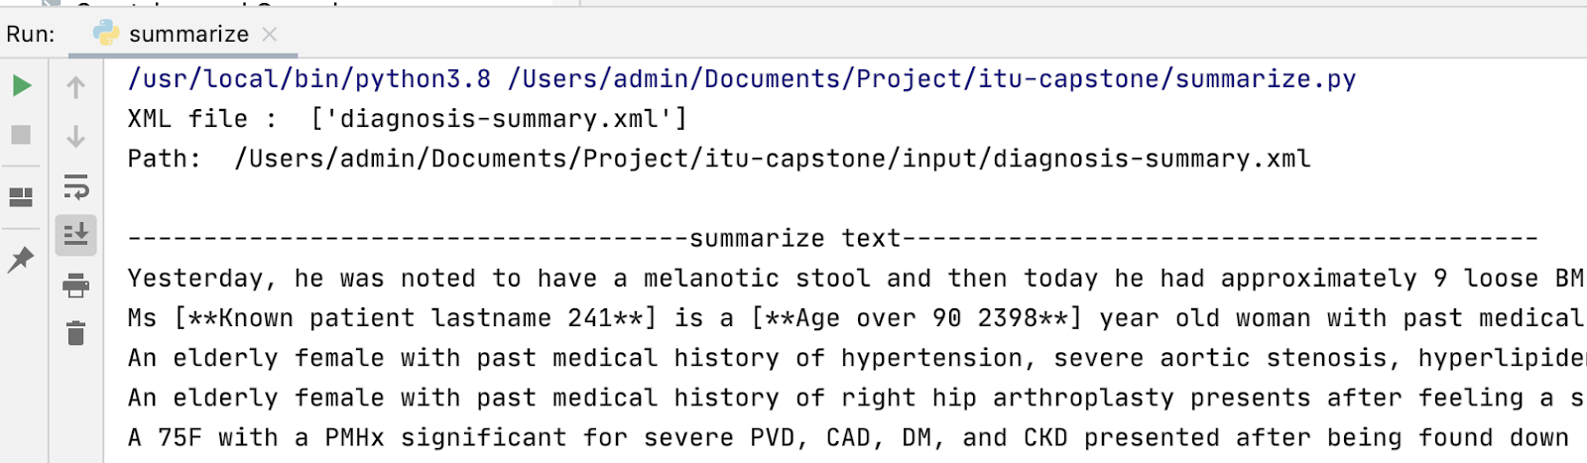
Output- Summarized article

Slide 33
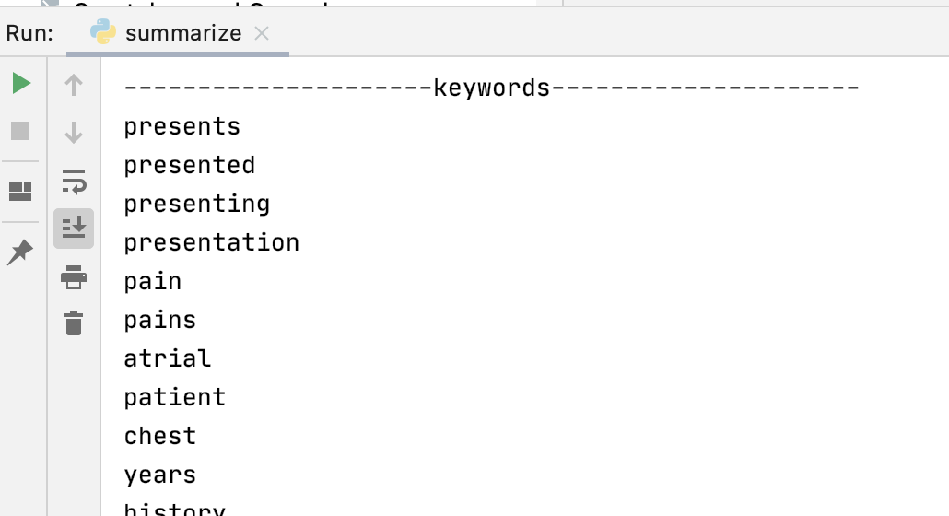
Searching Keywords

Slide 34
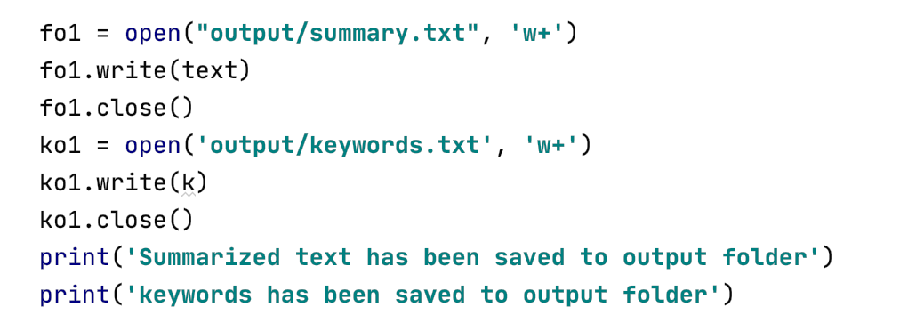
Writing into the file

Slide 35
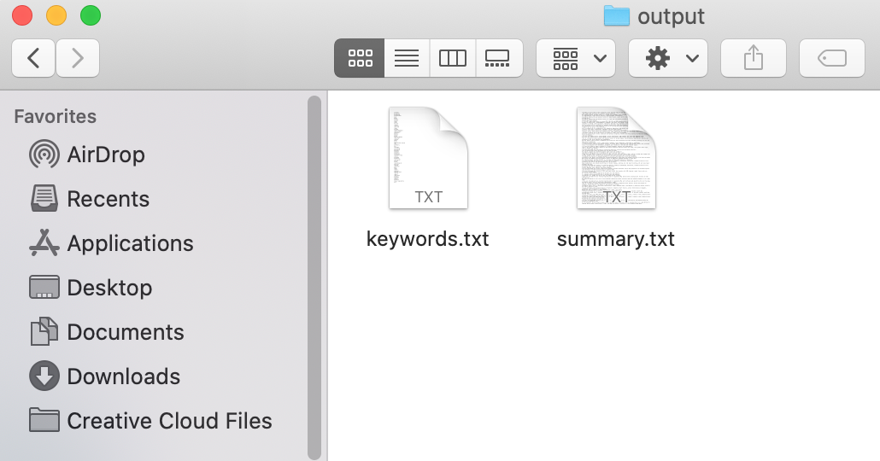
Storing Results

Slide 36
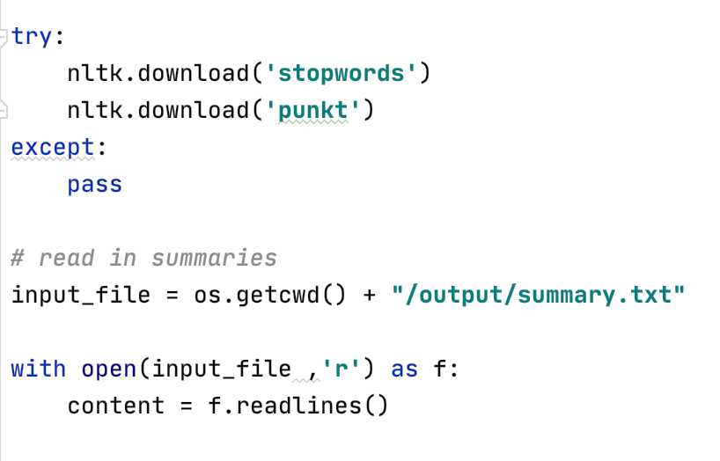
Reading Summary

Slide 37
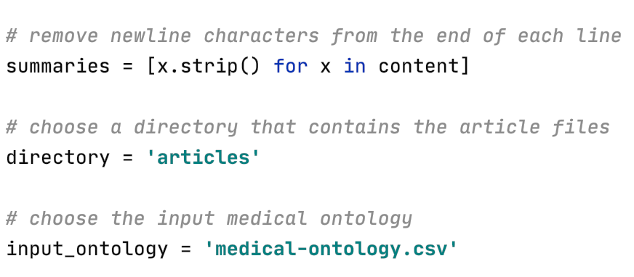
Taking input data

Slide 38
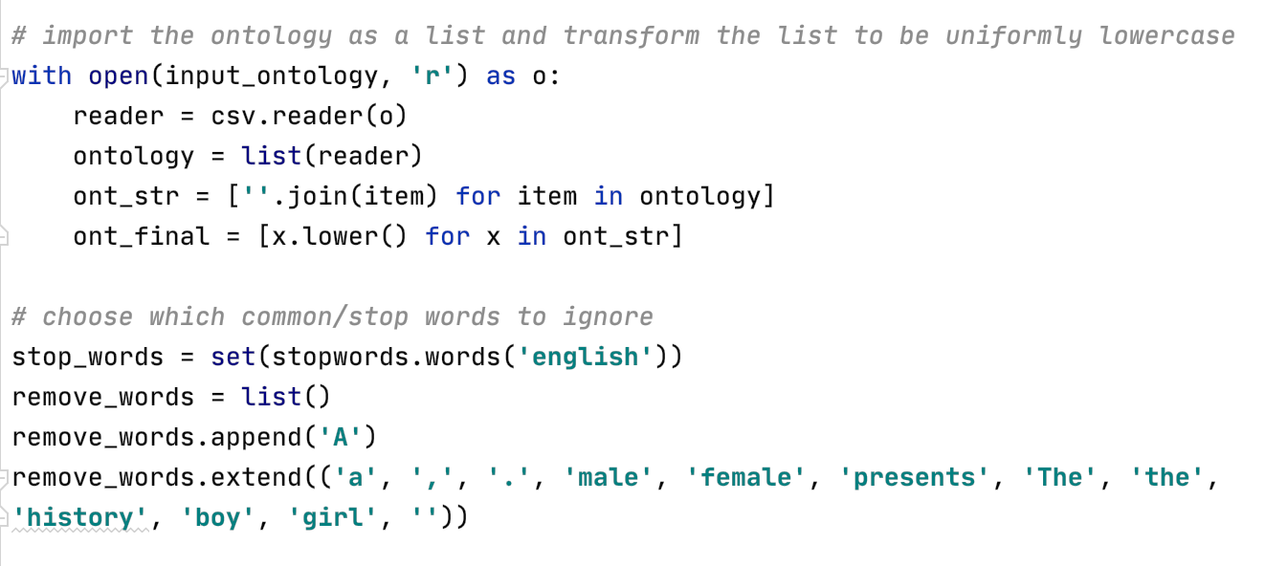
Working on input data

Slide 39
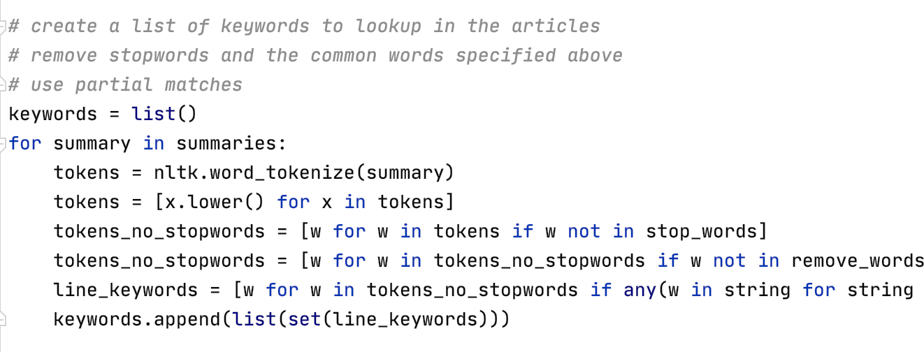
Remove stopwords and common words

Slide 40
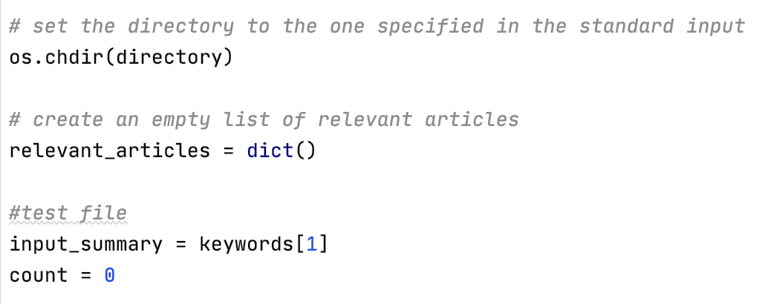
Creating directory for relevant articles

Slide 41
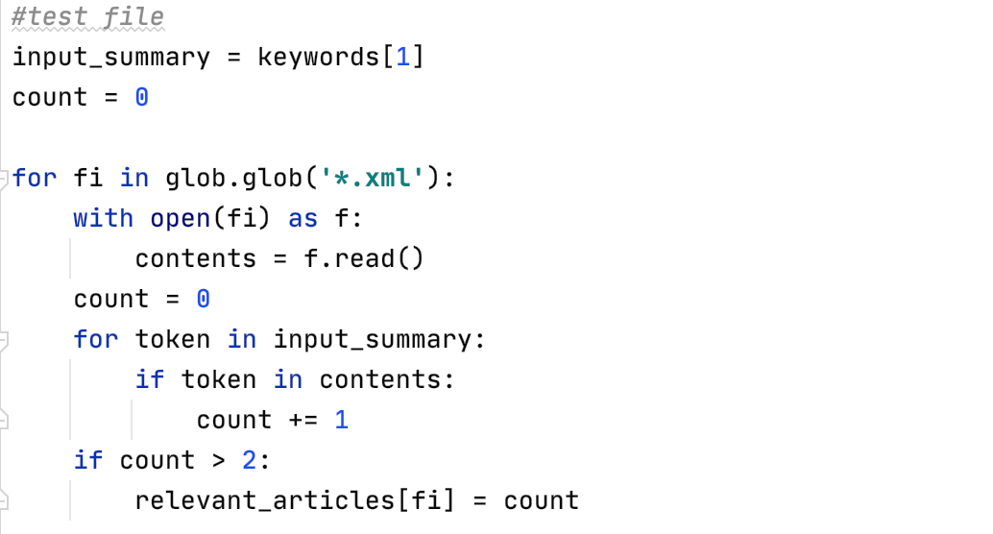
Test File

Slide 42
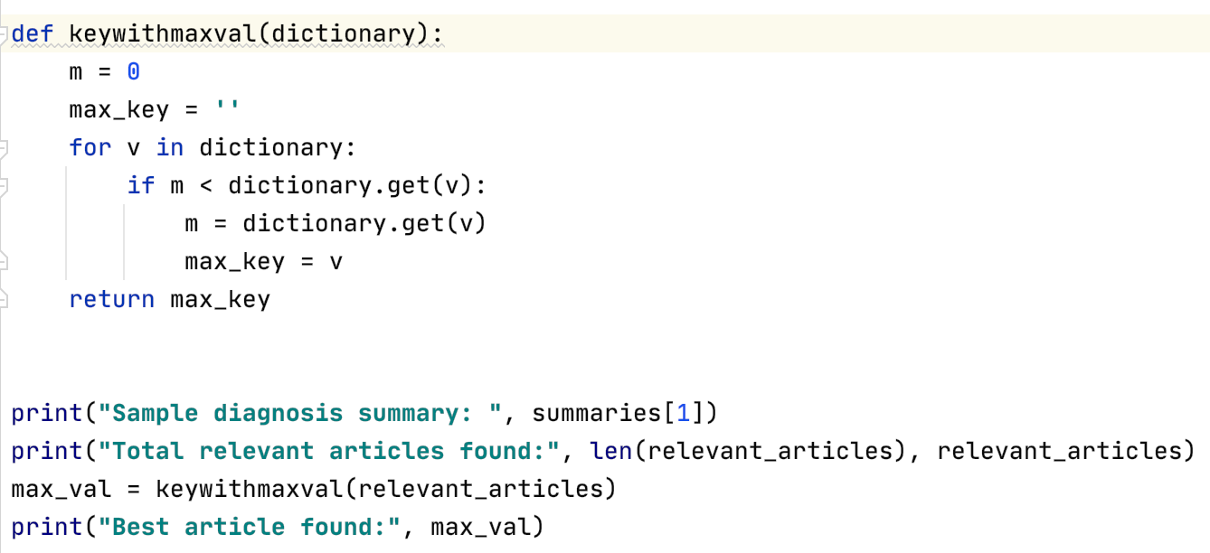
Finding most relevant article and display

Slide 43
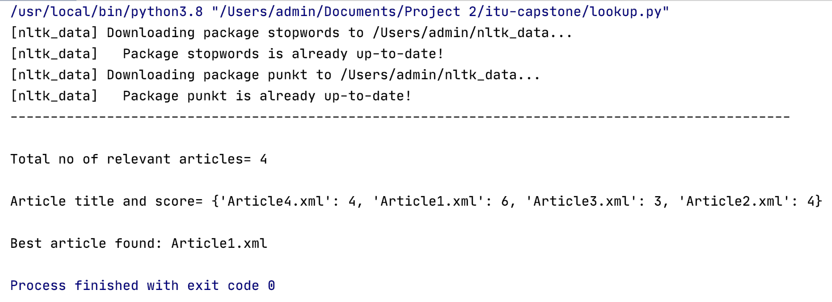
Output

Slide 44

PERFORMANCE

Slide 45

PERFORMANCE
Age Group
Features
Real time data monitoring
Cost factor
Timeline met
Scalable
Accurate results
Notes:
Emergency services can be served to any age group.
Our features helps doctor for serving patients well.
When our project is implemented to real time data monitoring it would be very efficient and useful for patients where real time data transmission can be planned.
Regarding cost factor it would help mutually for doctors and patients, which will be optimal.

Slide 46

CONCLUSION AND FUTURE WORK
Provides efficient way of decision-making on the emergency status.
Not only surgeons but also any emergency specialists, medical professionals, medical team members
Quicker and better results.
In future we will try additional summarization approaches & compare performance​

Slide 47

REFERENCES
B. Sun, W. Ma, and H. Zhao, “An approach to emergency decision making based on decision-theoretic rough set over two universes,” Soft Computing, vol. 19, no. 5, pp. 1–12, 2015.
A. Ebrahimian, N. Khalesi, G. Mohamadi, M. Tordeh, and M. Naghipour, “Transportation management in pre-hospital emergency with physiological early warning scores,” Journal of Health Administration, vol. 15, no. 49, pp. 7–13, 2012.
J. N. Fullerton, C. L. Price, N. E. Silvey, S. J. Brace, and G. D. Perkins, “Is the Modified Early Warning Score (MEWS) superior to clinician judgement in detecting critical illness in the pre-hospital environment?” Resuscitation, vol. 83, no. 5, pp. 557–562, 2012.
S. A. Mulholland, B. J. Gabbe, and P. Cameron, “Is paramedic judgement useful in prehospital trauma triage?” Injury, vol. 36, no. 11, pp. 1298–1305, 2005.
https://www.programiz.com/python-programming/regex
https://www.debuggex.com/cheatsheet/regex/python

Slide 48

Thank You!
Do you have any questions?

